Slide 1


Bistro Shelves
Created by
Sikeisha Luke and Kim Morton

Slide 2
Purpose of Bistro Shelves
Bistro Shelves is a Windows desktop application that allows a user to set “par” inventory levels for all products used in the Bistro. It then allows the user to regularly conduct inventory counts, records those counts with dates, then assists the user with ordering by suggesting the number of units needed to restore “par” levels for each product. The app is also able to display past inventory records.

Slide 3
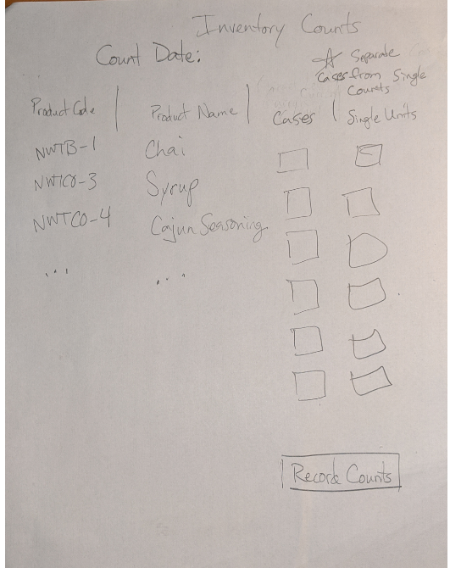
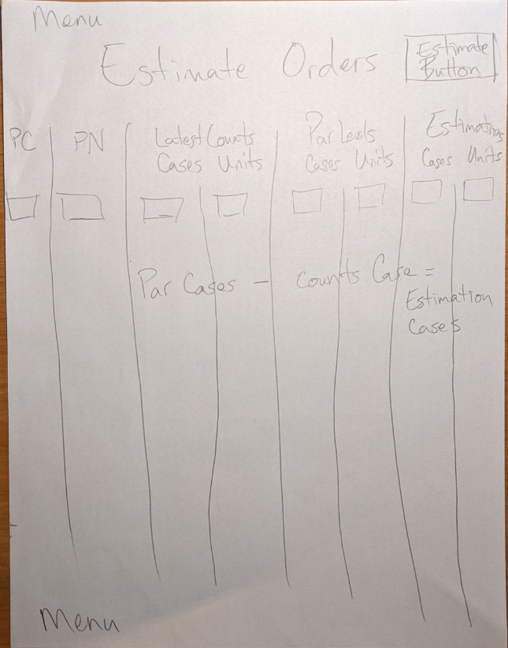
Design Documents
Notes:
Design planning for the Inventory Counts and Estimate Orders forms.

Slide 4
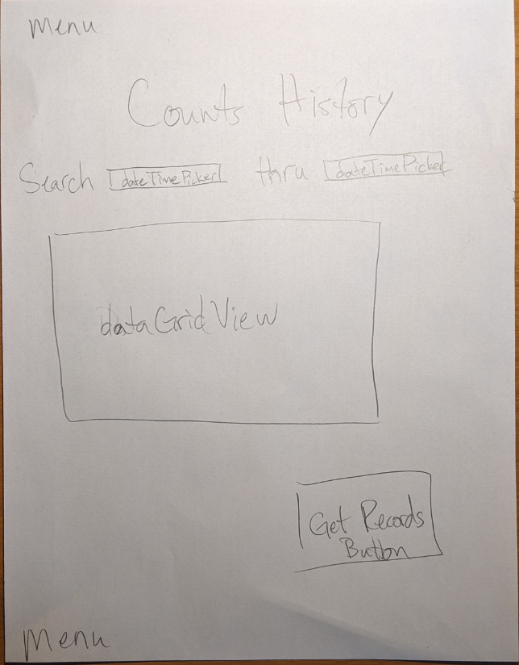
Design Documents Cont.
Notes:
Design planning for the Counts History form.

Slide 5
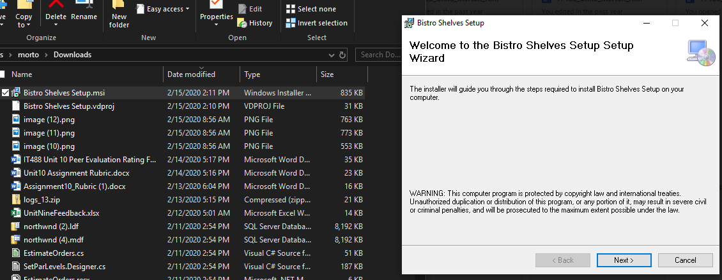
Demo product access or install procedure
Notes:
Double click Bistro Shelves Setup.msi for the wizard to run. Choose the location you want it to be stored on your local system.

Slide 6
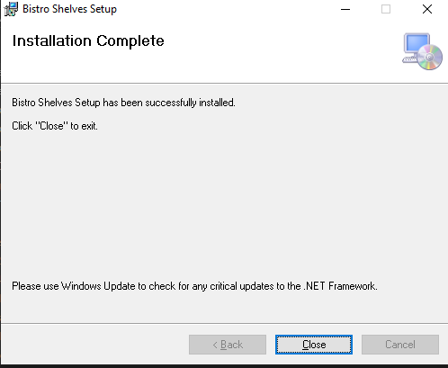
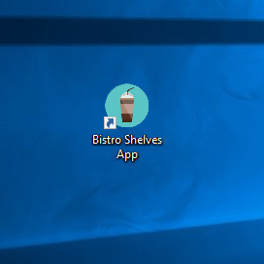
Installing Bistro Shelves
Notes:
Shortcut on my desktop for Bistro Shelves.

Slide 7
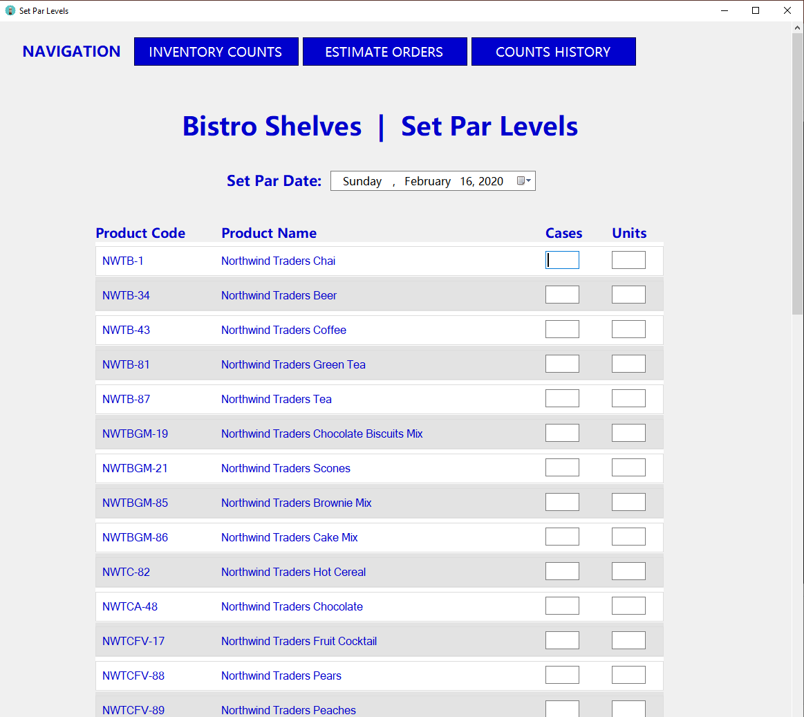
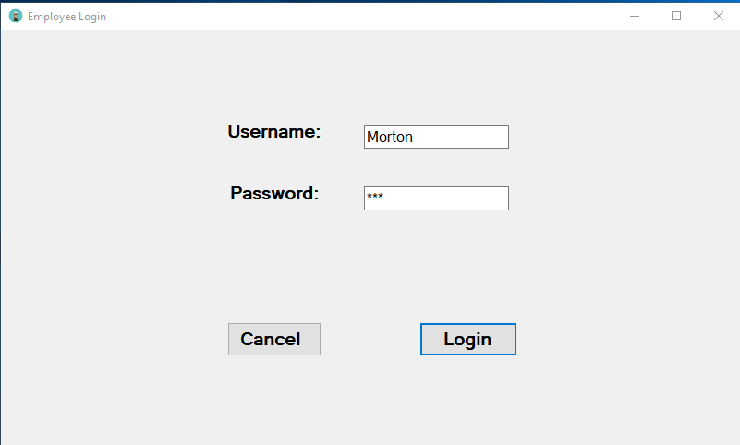
Product Demonstration
Notes:
Login form, Set Par Levels form

Slide 8
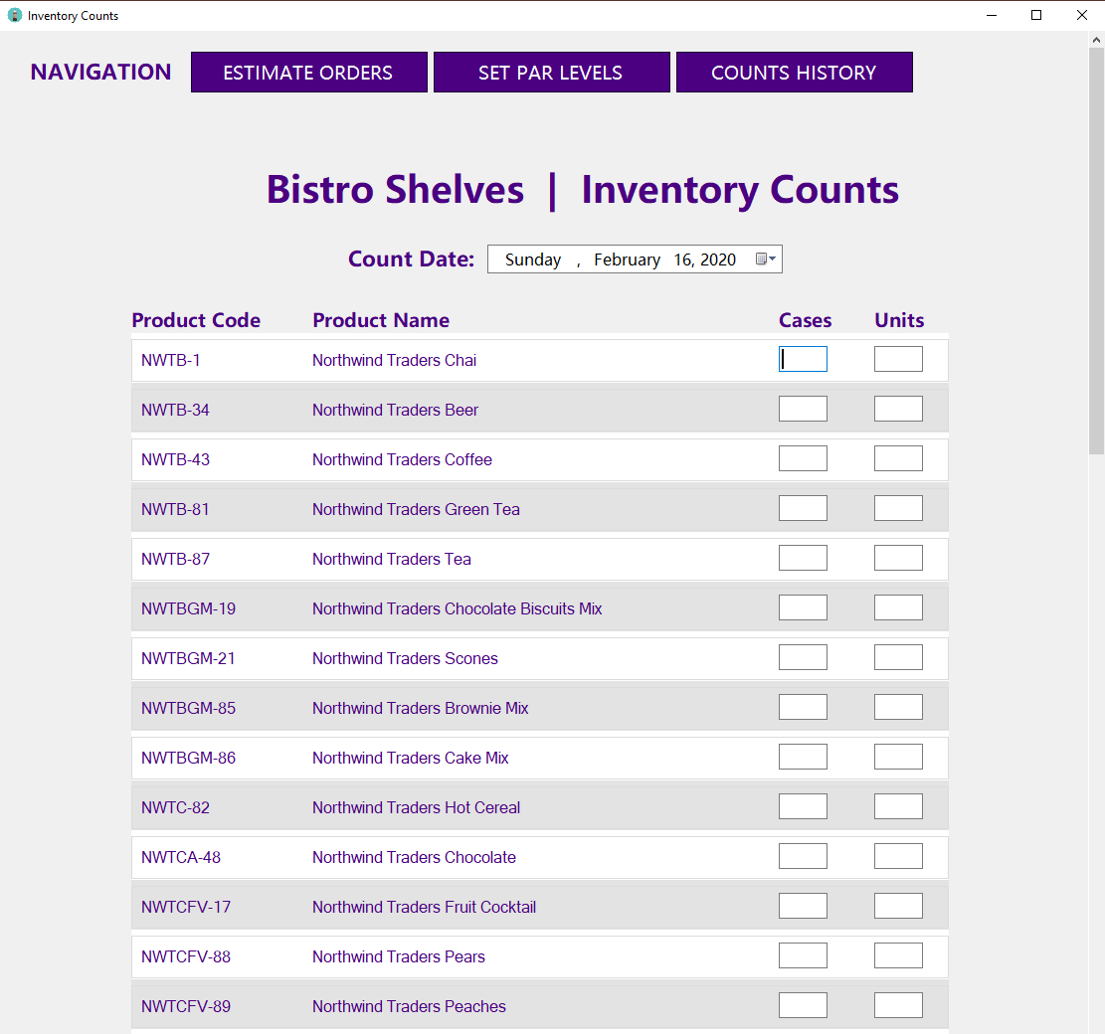
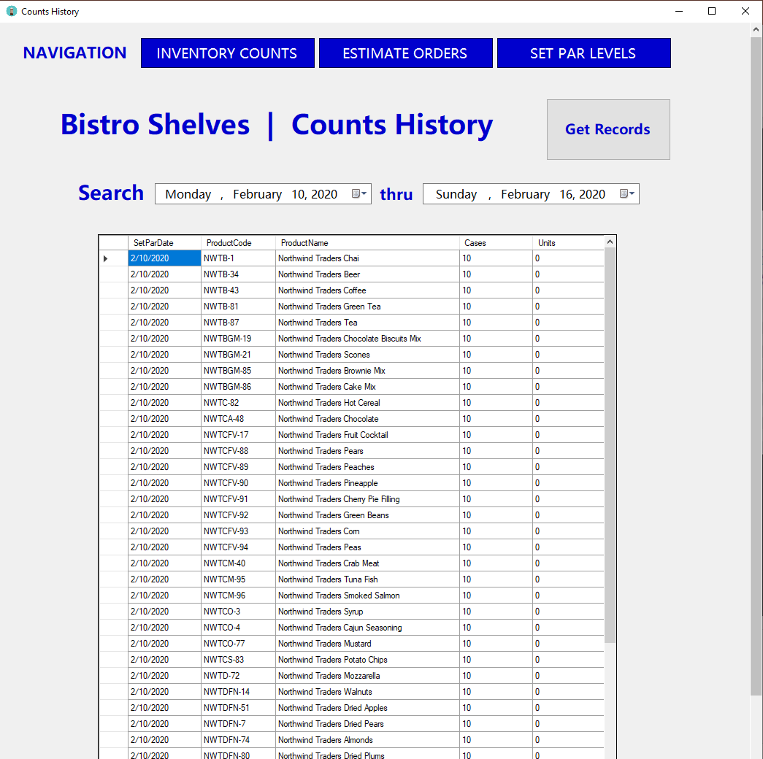
Product Demonstration Cont.
Notes:
Inventory Counts form, Counts History form

Slide 9
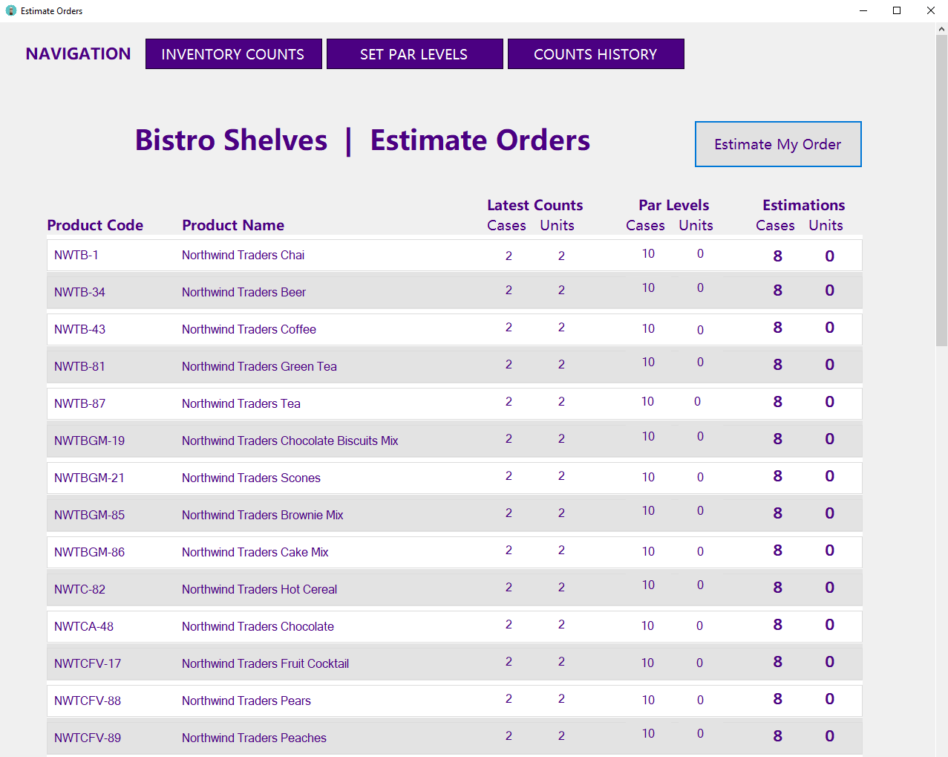
Product Demonstration Cont.
Notes:
Estimate Orders form, showing latest inventory counts, par levels and the estimation of cases and units for ordering.

Slide 10
Lessons Learned and Future Planned Improvements
Lessons Learned
Plan ahead for Microsoft Store app submission process
Future Planned Improvements
Configure a report view for printing the Inventory Counts form
Add printing capabilities to the Counts History form
Notes:
Reserving a name for the app for the Microsoft Store early on would have helped. It also costs money to reserve a name. Improving the program by adding a print option for the Counts History form.

